Slide 1
Driving faster decisions with excel and powerpoint
THIS COURSE IS NOT A TECHNICAL COMPUTER TRAINING COURSE. THIS COURSE WILL NOT PROVIDE SPECIFIC KEYPAD INSTRUCTIONS

Slide 2
WHO SHOULD ATTEND: Experienced management accountants, finance managers and finance business partners who need to influence decisions using visuals created on power point and excel.
This session will help you to:
Clarify the message and story you want to convey
Think about the design and visual impact
Use excel and PowerPoint in a focussed way
Take a more active role in leading decision making

Slide 3
BREAKOUT
Why
What
How

Slide 4

Current thinking
98%
96%
Lack of Financial Awareness
Poor Presentation of Data
Robust cost data
Lack of Financial Awareness
Robust cost data
Variability of cost and income data

Slide 5
Current thinking
Calculator
Dashboard
Coach
Leader

Slide 6
MY NUMBER 1 TOOL
Analysing using the power of 3

Slide 7
DECISIONS ARE ABOUT 3 THINGS…
Build relationships
+
Turn data to insights
+
Bring numbers to life
With excel & pp
DECISION

Slide 8
HOW THE RULE OF 3 WORKS
BREAKOUT:
1 WRITE A LIST OF EVERYTHING YOU WANT TO SAY
2 PICK THE 3 MOST IMPORTANT DECISIONS
3 SAVE THE REST FOR ANOTHER DAY

Slide 9
BREAKOUT:
In pairs discuss, show and tell your reports
1 Give feedback on your own report to drive faster decisions
2 Ask for feedback from your colleague
3 Make 3 decisions in how you could change your report where the outcome would help drive faster decisions

Slide 10
HOW CAN WE WORK TOGETHER TO MAKE YOUR JOB EASIER?
Today we’re going to talk about 3 things…
DECISION 1
DECISION 2
DECISION 3
1.
2.
3.
1.
2.
3.
1.
2.
3.
Today we talked about 3 things…recap the 3 key messages
WHAT DO YOU FEEL WE COULD WORK ON NEXT?

Slide 11
BREAKOUT:
In groups discuss, create a power presentation slide and prepare to brief back so
1 What decisions you’ve made to your reports
2 Why it will make their job easier

Slide 12
MY NUMBER 2 TOOL
Reporting using insight to drive faster decisions

Slide 13
“ It’s not in the budget”

Slide 14
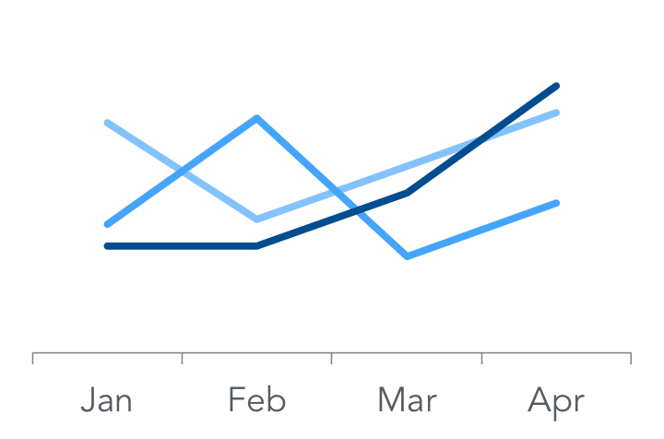
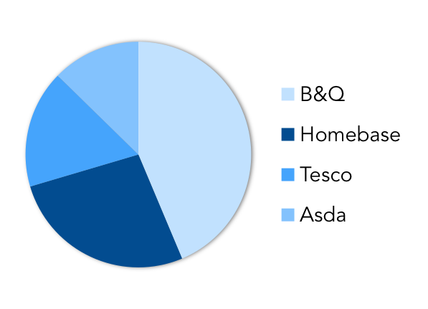
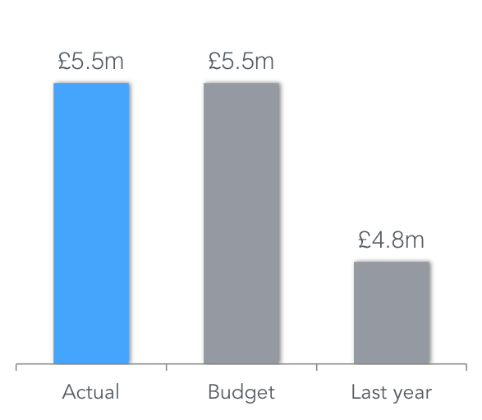
Period 6 financials
 |  |  | P6 |  |  |  |  |  | YTD |  |  |  |  |  | Full Year
 | Act | Bud | Lyr | % B | % L |  | Act | Bud | Lyr | % B | % L |  | Act | Bud | Lyr | % B | % L
Volume | 2.1 | 2.2 | 2.3 | -4% | -9% |  | 12.6 | 13.2 | 13.8 | -4% | -9% |  | 25.2 | 26.4 | 27.6 | -4% | -9%
Gross sales | 5.5 | 5.5 | 6.2 | -1% | -12% |  | 32.8 | 33.0 | 37.3 | -1% | -12% |  | 65.5 | 66.0 | 74.5 | -1% | -12%
Rebates | 0.7 | 0.7 | 0.7 | 1% | -6% |  | 4.0 | 4.0 | 4.2 | 1% | -6% |  | 8.0 | 7.9 | 8.5 | 1% | -6%
Net sales | 4.8 | 4.8 | 5.5 | -1% | -13% |  | 28.8 | 29.0 | 33.0 | -1% | -13% |  | 57.5 | 58.1 | 66.0 | -1% | -13%
Variable costs | 2.7 | 2.7 | 3.0 | 0% | -10% |  | 16.0 | 16.0 | 17.8 | 0% | -10% |  | 32.1 | 31.9 | 35.7 | 0% | -10%
Gross margin | 2.1 | 2.2 | 2.5 | -2% | -16% |  | 12.7 | 13.1 | 15.2 | -2% | -16% |  | 25.4 | 26.1 | 30.4 | -2% | -16%
Fixed costs | 0.9 | 0.9 | 1.0 | 0% | -8% |  | 5.5 | 5.5 | 5.9 | 0% | -8% |  | 11.0 | 11.0 | 11.9 | 0% | -8%
Trading profit | 1.2 | 1.3 | 1.5 | -4% | -22% |  | 7.2 | 7.6 | 9.2 | -4% | -22% |  | 14.4 | 15.2 | 18.5 | -4% | -22%
GIV ppl | 2.6 | 2.5 | 2.7 | 4% | -4% |  | 2.6 | 2.5 | 2.7 | 4% | -4% |  | 2.6 | 2.5 | 2.7 | 4% | -4%
Rebates % | 12.2% | 12.0% | 11.4% | 2% | 7% |  | 12.2% | 12.0% | 11.4% | 2% | 7% |  | 12.2% | 12.0% | 11.4% | 2% | 7%
GM% | 44.2% | 45.0% | 46.0% | -2% | -4% |  | 44.2% | 45.0% | 46.0% | -2% | -4% |  | 44.2% | 45.0% | 46.0% | -2% | -4%
Fixed costs % | 19.1% | 18.9% | 18.0% | 1% | 6% |  | 19.1% | 18.9% | 18.0% | 1% | 6% |  | 19.1% | 18.9% | 18.0% | 1% | 6%
Profit % | 25.1% | 26.1% | 28.0% | -4% | -10% |  | 25.1% | 26.1% | 28.0% | -4% | -10% |  | 25.1% | 26.1% | 28.0% | -4% | -10%
Sales -4% vs. budget due to phasing
Gross margin 3 points below budget due to one-off releases
Fixed costs 2% below budget due to accrual releases from Q1

Slide 15
INSIGHT
THE FUTURE
FOR YOUR
CAREERS
INSIGHT
SO WHAT
INFO
DRIVER
WHY
SURFACE
AUTOMATION
AI
RPA
DATA
WHAT

Slide 16
DATA
INFO
INSIGHT
>
>
What has happened
Why it happened
How we can improve the future
Sales are 4% below last year
A competitor launched at a lower price
How can we reduce our price or improve our offer to take back share?

Slide 17
HOW THE RULE OF 3 WORKS
BREAKOUT:
1 WRITE A LIST OF EVERYTHING YOU WANT TO SAY
2 PICK THE 3 MOST IMPORTANT DECISIONS YOU’D LIKE TO INFLUENCE WITH A STAEKHOLDER
3 SAVE THE REST FOR ANOTHER DAY

Slide 18
5 WHYS
5% adverse variance spend in April 2019
INSIGHT: How could we improve the staff planner to improve resource planning to meet patient demand?
WHY: Due to pay costs
WHY: Due to more than planned agency staff
WHY: Due to the need to cover Easter holidays
WHY: Due to an ineffective staff planner
WHY: Due to a manual staff planner

Slide 19
BREAKOUT:
In pairs discuss:
Who is the stakeholder
3 insight led decisions you’d like to influence
Ask for feedback from your colleague

Slide 20
MY NUMBER 3 TOOL
SELL THE DECISION RATHER THAN TELL THE DECISION

Slide 21
  Pick 5 key stakeholders
  Where does each person sit? Put them into the 3 circles (Comfort, Risk and Panic)?
  Why have you put each person where you have?
  Are there any patterns that emerge?
  Which 1 or 2 people is it really important for you to be more inquisitive and inclusive with?
Panic Zone
Risk Zone
Comfort Zone

Slide 22
EVENT
+
=
RESPONSE
OUTCOME

Slide 23
7 38 55

Slide 24
1. Listening partner
2. Thinker

Slide 25
Relationship
Your focus is on:
Listening for DEPTH
…their words, feelings, body, tone, perspective, experience
Listening for MEANING
…their words
Listening to
SELF
…your perspective
Based on work of Whitworth et al (2007)

Slide 26
Four helpful behaviours
Presence
Silence
Work with
Inner Voice
Active
Listening

Slide 27
POWER QUESTIONS
Delete
Lack of reference “ They don’t listen to me”
Comparison “She’s a better person”
Distort
Mind Reading “You don’t like me”
Cause & Effect “You make me sad”
Generalise
Everyone, always, no one, never
Possibility / Necessity “ could, couldn’t, may, may not – Should, shouldn’t – Must must not

Slide 28

POWER QUESTIONS
7 +-2 Chunks Internal Representations
Filters
Delete
Generalise
Distort
Time/Space Matter/Energy
Events
Language
Memories
External Event
Decisions
State
Meta Programs
Values & Beliefs
Attitudes
Behaviour
Physiology
Notes:
Describe coming to a training with positive mind set verus negative mindset despite external events being the same.
Vice president, finance, Unilever, said: 'Firstly, we’re trying to provide the tools. But then, for the decision itself to be effective and make an impact you also need to change the behaviour of people. Top firms taking on Finance Transformation…CIMA Nov 2008

Slide 29
What
Why
How

Slide 30
POWER QUESTIONS
  Open
    Why,what,how,when,who,where
  Specificity
    What specifically, Can you give me an example of that
  To see the bigger picture
    What’s the purpose?, What does that mean?

Slide 31
Mirroring
You are like them
You have listened
You have understood
You are talking their language
You are on their wavelength
Notes:
31

Slide 32
MY NUMBER 4 TOOL
FRONT COVER

Slide 33
Power title
@ ICAEW 2018

Slide 34
HOW CAN WE ACCELERATE OUR CIP PLANS?
-3%
x5
COST PER PATIENT
RETURN on
INVESMENT
Is DOWN 3% year on year due to new MI visibility and education campaign
Our latest procurement initiative cost £30k and generated net value of over £150k
SO WHAT?
94%
How could we:
Do more procurement initiatives?
Reduce more waste?
Share our success?
PATIENT
SATISFACTION
94% of our patients give us a 5 star rating and would recommend us!

Slide 36
A: Graph illustrating patients treated and referrals

Slide 37
B: How could we increase patient throughput ?
Patients Treated

Slide 38
Make it different
London Congestion Charging Strategic Risks (Bubble size equates to risk impact)
Probability of Occurrence
Realisation Date
Notes:
MS

Slide 39
How excel can help

Slide 40
Excel Tips
What is the insight you want to show?
What decision does it enable?
POWER HEADING
Maximise white space
One picture
Three messages

Slide 41
Finance graphs
Horizontal bar is better than vertical
The finance gap chart
Slope charts
Waterfalls

Slide 42
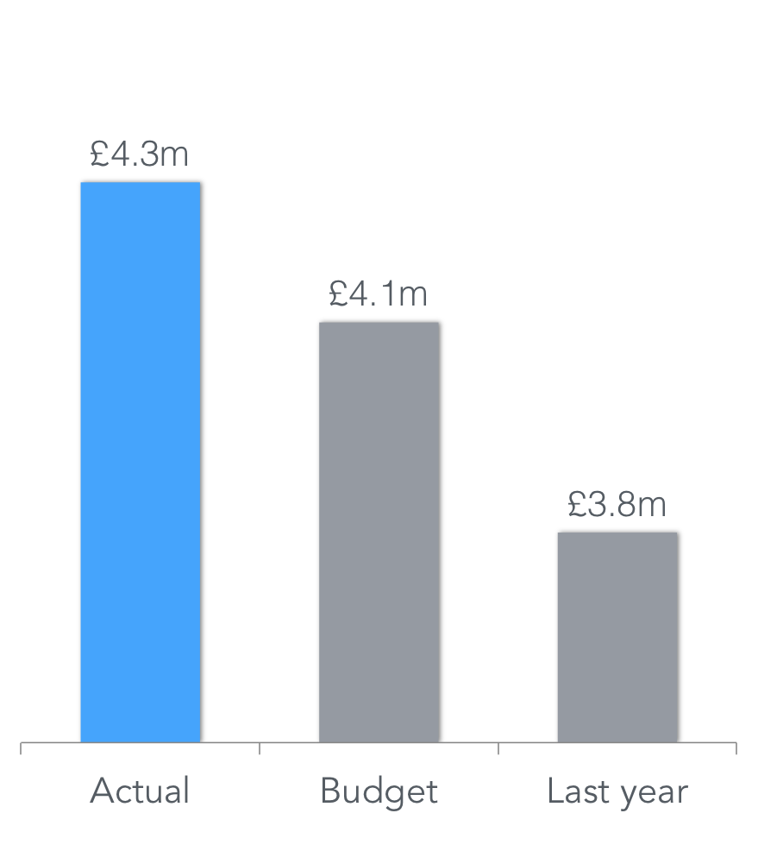
Bar charts
Vertical
Horizontal

Slide 43
Gap charts
Budget
£9.4m
Actual £7.8m
Gap
£1.6m
DATA = What?

Slide 44
Gap charts
Budget
£9.4m
Over
£0.9m
DATA = What?

Slide 45
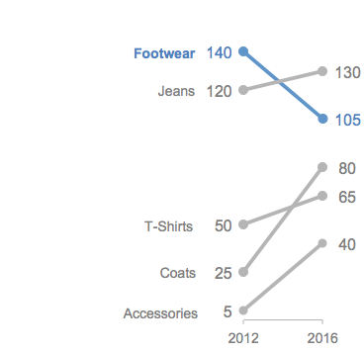
Slope charts
Sales £m | 2012 | 2016 | Var | %
Footwear | 140 | 105 | -35 | -25%
Jeans | 120 | 130 | 10 | 8%
T-Shirts | 50 | 65 | 15 | 30%
Coats | 25 | 80 | 55 | 220%
Accessories | 5 | 40 | 35 | 700%

Slide 46
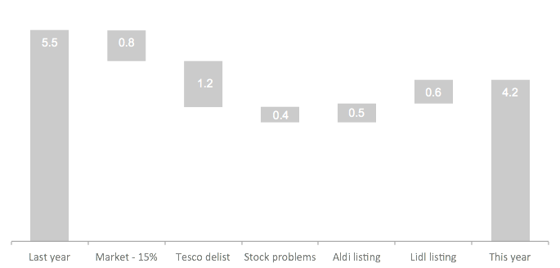
Waterfall

Slide 47
How power point can help

Slide 48
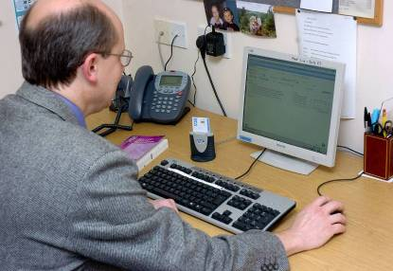







High Level Overview and Observations
PRIMARY CARE – FAMILY DOCTOR
SECONDARY CARE – HOSPITAL
Choose &
Book System
Doctors object to “Choice”
Contract let Sept 2003
New interface – no contract
Contract let Nov 2003
New NHS
Network
Legacy
Doctor’s
System
Legacy
Hospital
System
New call centre needed
New interface – no contract
New IT Application Services (BT Health):
Transaction messaging services
Patient Demographic Services
User Security Services
Call Centre
Contract let Nov 2003
Patient Web Access

Slide 49
Powerpoint
Supporting the NHS Transformation Strategy
The vision
The Big 5 – 5 in 5
5 yr plan
4m PbR
£3bn
2m new
patients
1 vision
Zero harm
Service Expansion
PLICS
100k new service lines
Growth + flat CO2 emissions
Nurture people
Efficient service
Sustainability
Focus – What, Where & When
Plans - How
Business Partner / Stakeholder Management
Transformation
Delivery
High Performing team
Patient Focus

Slide 50

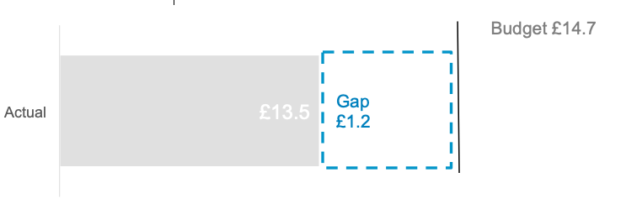
Investing in staff retention and recruitment POST COVID-19
<
<
15% Doctors retire in our Trust in 2021
Staff resilience and well-being is underspent
<
<
Recommendations:
How could we increase the participation of resilience training?
How could we bring retired Doctors back to support transition plans?
How could we train managers to remotely support teams during Q3 & Q4?
40%
Low staff morale due COVID-19 fatigue

Slide 51
MY NUMBER 5 TOOL
PREPARE THE MEETING

Slide 52
Remote

Slide 53
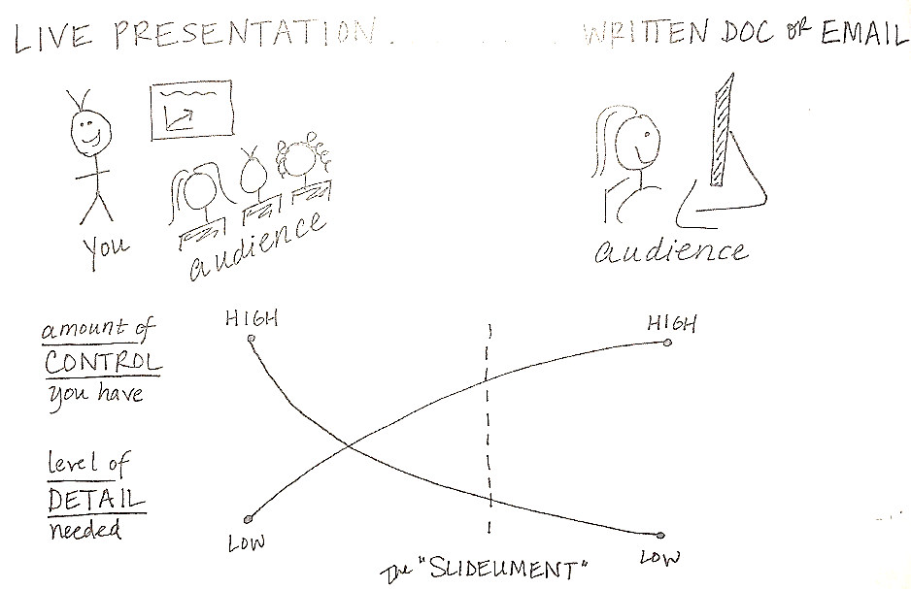
Remote

Slide 54
PREPARE THE MEETING
How does this make you feel about them?
  Send emails during the meetings
  Turning off their webcam
  Talking over you
  Not listening to you
  Looking disinterested when you speak
  Consistently turning up late and leaving early
  Never taking an interest in how you are
  Avoiding addressing the ”elephant in the room”
  Avoiding challenging other people’s inappropriate behaviour

Slide 55
Remote meeting
Why
What
How

Slide 56
BREAKOUT:
In groups discuss, create a power presentation slide and prepare a brief back
1 What to prepare before the meeting
2 How to behave in the the meeting
3 How to maximise engagement

